Slide 1
Effects of Darkness on Vision
Making Night Operations Safer

Slide 2
Agenda
Introduction and Concepts
Introduction
Understanding the how the eye works - Cones vs Rods
Blind Spots
Acclimation to darkness
Handling bright lights
Depth perception
Night visual illusions
Autokinesis
False horizon
Size-distance illusion
Flicker vertigo
Reversible perspective
Terrain slopes illusion
Featureless terrain illusion
Atmospheric illusion
Ground lighting illusion
UAS Night operation procedures
Equipment and Procedures
Protecting night vision
Takeoff and landing zone
Pre-flight briefing
Communications
Operational limitations
Horizontal speed
Vertical speed
Altitude

Slide 3
Introduction and Concepts

Slide 4
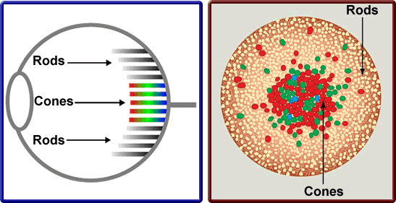
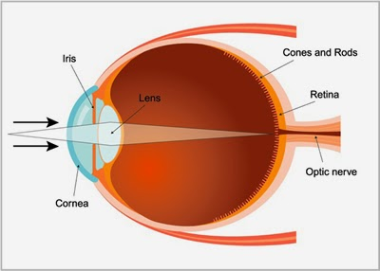
Understanding the how the eye works - Cones vs Rods
Anatomy of the Eye
Cones
High intensity light
Perceive color
Detail
Depth perception
Center of Retina
Rods
Low intensity light
Peripheral vison
Located mainly towards outside of retina
Notes:
Cones are used for day or high-intensity light vision. They are involved with central vision to detect detail, perceive color, and identify far-away objects.
Rods are used for low-light intensity or night vision and are involved with peripheral vision to detect position references including objects (fixed and moving) in shades of grey, but cannot be used to detect detail or to perceive color.

Slide 5
Blind Spots - Anatomical
Blind spot where the optic nerve connects to the retina
Cover left eye and focus on blue cross. Then slowly walk towards screen until the square disappears
Notes:
The area where the optic nerve connects to the retina in the back of each eye is known as the optic disk. There is a total absence of cones and rods in this area, and, consequently, each eye is completely blind in this spot

Slide 6
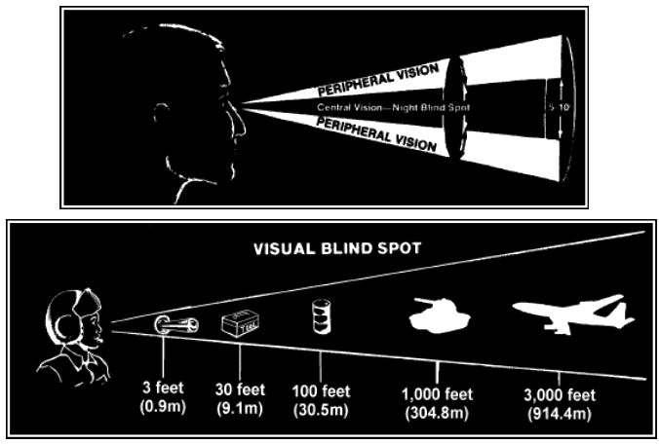
Blind Spots - Night
Occurs in low light
5 to 10 degrees in the center of vision
Notes:
The area where the optic nerve connects to the retina in the back of each eye is known as the optic disk. There is a total absence of cones and rods in this area, and, consequently, each eye is completely blind in this spot

Slide 7
Acclimation To Darkness
Eye adapting to darkness
Avoid Carbon Monoxide (smoking or fumes)
Vitamin A
Avoid bright lights
Set cell phones/tablet screens to lowest light possible
Scan and look with peripheral vision
10 degrees off center (above or to the side)
Notes:
Anti-collision lights do not affect night vision because they flash for less than 1 second.

Slide 8
Handling Bright Lights
Cover one eye
Look away
Utilize red light as much as possible

Slide 9
Depth Perception
Cones provide depth perception
In low light Rods are used over Cones
Spatial clues
Proper scanning – stop, turn, stop, turn

Slide 10
Night Visual Illusions

Slide 11
Autokinesis
Objects appear to move if stared at
Avoid it, by focusing on various objects at various distances
Don’t fixate on an object

Slide 12
False Horizon
Occurs what the natural horizon can not be seen
Caused by bright stars or city lights
Can also be caused stars reflecting off water
Slanted free way lights
Sloping clouds

Slide 13
Size-Distance Illusion
Angles can affect perceived size and/or distance
Cones in the eye can’t assist at night
Bright lights seem closer
Dim lights seem father away

Slide 14
Flicker Vertigo
Flashing lights
Can cause:
Nausea
Dizziness
Headaches
Confusion

Slide 15
Other Types of Illusions
Reversible Perspective | Objects may appear they are going away when in fact they are approaching
Terrain Slopes Illusion | Perceived to be too high or low due to slope
Featureless Terrain Illusion | Perceived to be higher
Atmospheric Illusion | Rain can cause illusion of greater height. Haze can create illusion of being farther away
Ground Lighting Illusion | Confuse ground lighting with stars. Bright lights can seem closer

Slide 16
UAS Night Operation Procedures

Slide 17
Equipment and Procedures
Procedures
Minimum of one Visual Observer
Determine minimum safe altitude
Dedicated and protected take off and landing zone
Hand lights to see obstacles
Return To Home altitude set to known minimum safe altitude
UAS Equipment
First Person View Camera
Anti-Collision lights
Cameras
Thermal Imaging
Or, Zoom(Z3) with spot lights
Or X5 with zoom lens and spot lights

Slide 18
Protecting Night Vision
Cover or close one eye when around bright lights
Pirates used to do it, hence the eye patch
Utilize Red lighting whenever possible
Try to be aware of scene lighting
Don’t stare at the flashing lights
Look down and away from bright lights

Slide 19
Takeoff And Landing Zone
Protected area that is clearly defined and lighted well
Preferably a 20 x 20 foot zone that is unobstructed vertically
Landing Zones less than 15 x 15 foot must be approved by the Lead Pilot
Preferably a flat hard surface
Preferably in the cold zone, but may be in the warm zone
Never the hot zone.

Slide 20
Pre-flight Briefing
Type of Operation
Review Operation Map
Landing / Take Off Zone
Review known hazards
Visual Observer Positions
Communications
Identifiers / Call Sign
Radio Channels
Emergency Protocols
Fly-away
Loss of signal
Loss of power

Slide 21
Communications
Communications between the RPIC and VO(s) is critical
Radio Channel should be dedicated for RPIC and VO(s)
“Necessary only” communication with RPIC and VO(s)

Slide 22
Operational Limitations
Operation | Limitation
Maximum Altitude | 200 ft Above Ground Level
Maximum Vertical Speed | 7 mph or 3.1 meters per second
Maximum Horizontal Speed | 20 mph or 9 meters per second

